Slide 1
Hypothesis Test

Slide 2

Hypothesis test
There is a basketball player who claimed to be an 80% free-throw shooter.
In an SRS of 50 free throws, he made 20.
His sample proportion of making shots is 20/50 = 40%.
Much lower than what he claimed!!!!
How about he made 38 out of 50 free throws?
His sample proportion is very close to 80%...
Now we need convincing evidence against his claim!

Slide 3
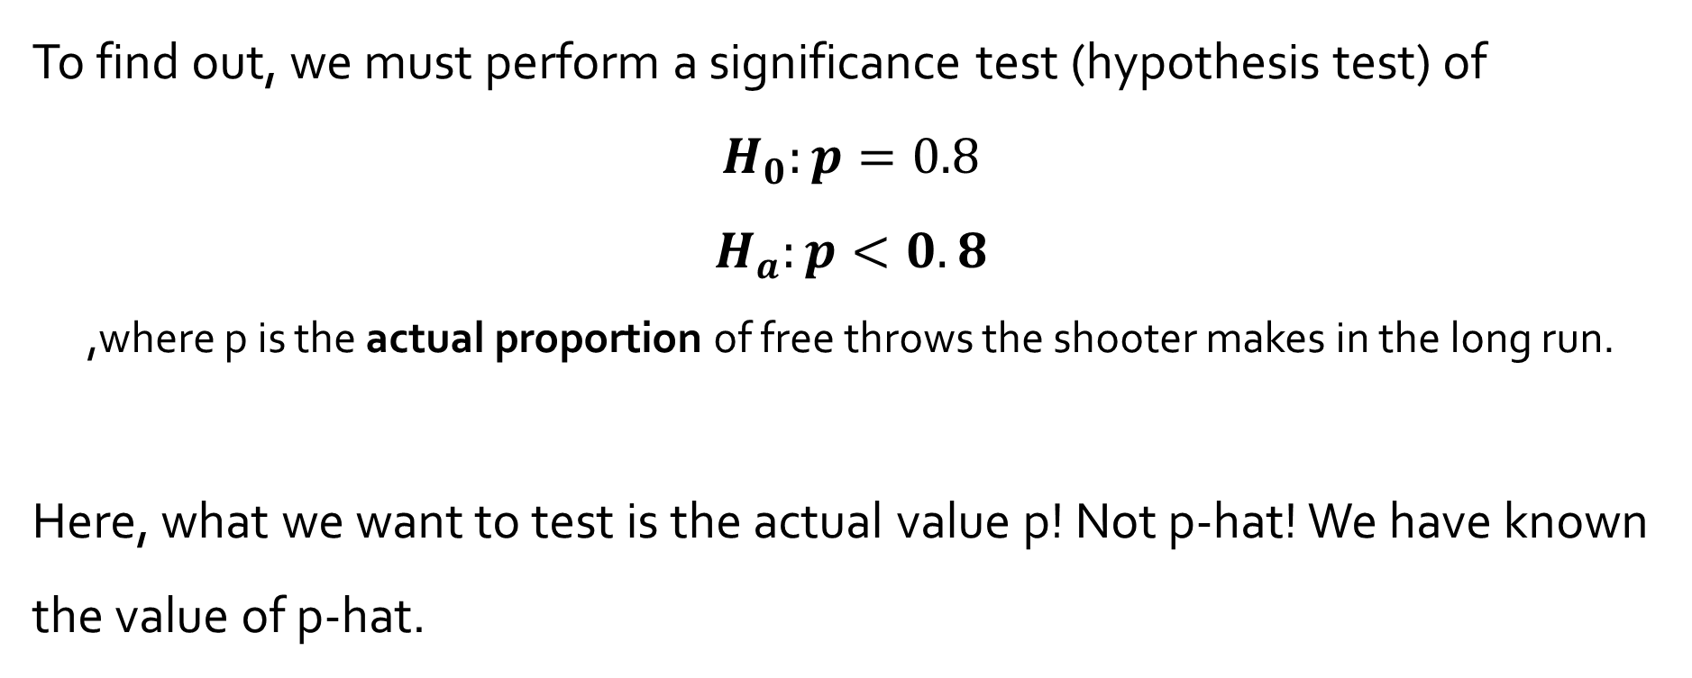
Hypothesis test
To find out, we must perform a significance test (hypothesis test) of
$$H_{0}:p=0.8$$
$$H_{a}:p<0.8$$
,where p is the actual proportion of free throws the shooter makes in the long run.
Here, what we want to test is the actual value p! Not p-hat! We have known the value of p-hat.
Null Hypothesis →
Alternative Hypothesis →
Claim
We prefer to accept

Slide 4
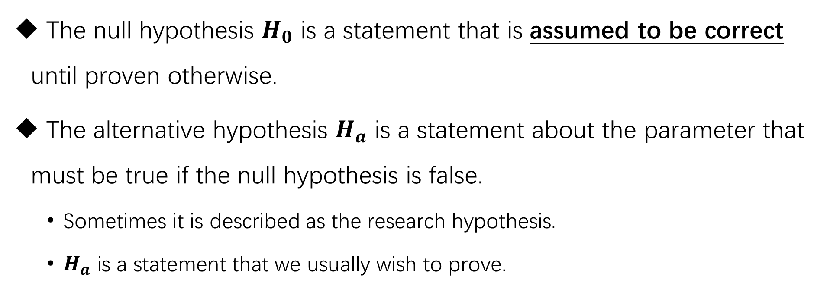
Hypothesis statement
The null hypothesis $H_{0}$ is a statement that is assumed to be correct until proven otherwise.
The alternative hypothesis $H_{a}$ is a statement about the parameter that must be true if the null hypothesis is false.
Sometimes it is described as the research hypothesis.
$H_{a}$ is a statement that we usually wish to prove.

Slide 5
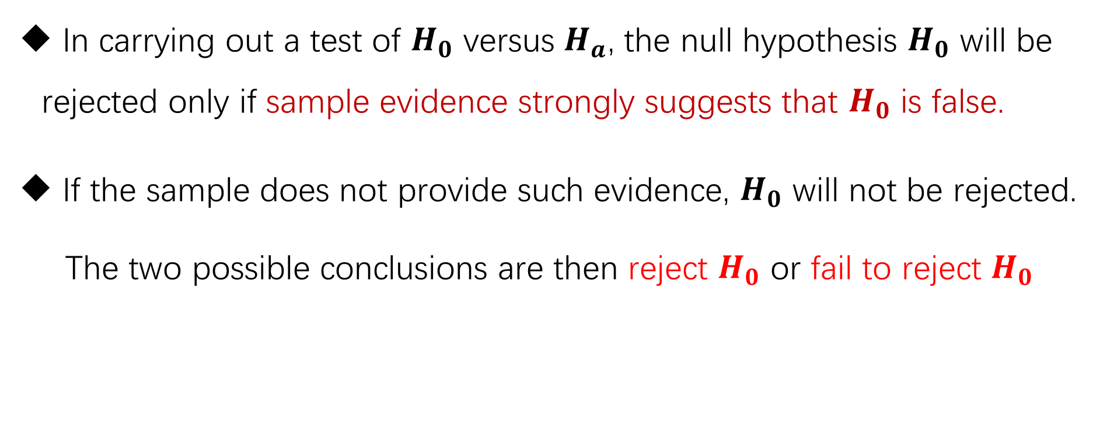
Hypothesis statement
In carrying out a test of $H_{0}$ versus $H_{a}$, the null hypothesis $H_{0}$ will be rejected only if sample evidence strongly suggests that $H_{0}$ is false.
If the sample does not provide such evidence, $H_{0}$ will not be rejected.
The two possible conclusions are then reject $H_{0}$ or fail to reject $H_{0}$

Slide 6
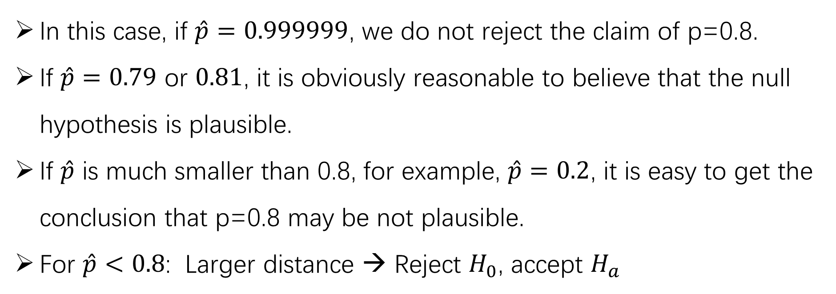

Types of tests
$$H_{0}:p=0.8$$
$$H_{a}:p<0.8$$
left-tailed test
In this case, if $\hat{p}=0.999999$, we do not reject the claim of p=0.8.
If $\hat{p}=0.79$ or $0.81$, it is obviously reasonable to believe that the null hypothesis is plausible.
If $\hat{p}$ is much smaller than 0.8, for example, $\hat{p}=0.2$, it is easy to get the conclusion that p=0.8 may be not plausible.
For $\hat{p}<0.8$: Larger distance → Reject $H_{0}$, accept $H_{a}$

Slide 7



Types of tests
$$H_{0}:p=0.8$$
$$H_{a}:p<0.8$$
left-tailed test
$$H_{0}:p=0.1$$
$$H_{a}:p>0.1$$
right-tailed test
$H_{0}:p=0.5$ (fair coin for example)
$$H_{a}:p≠0.5$$
two-tailed test

Slide 8
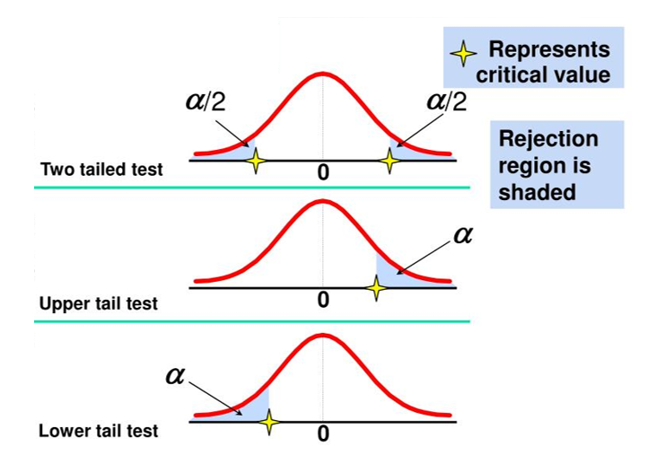
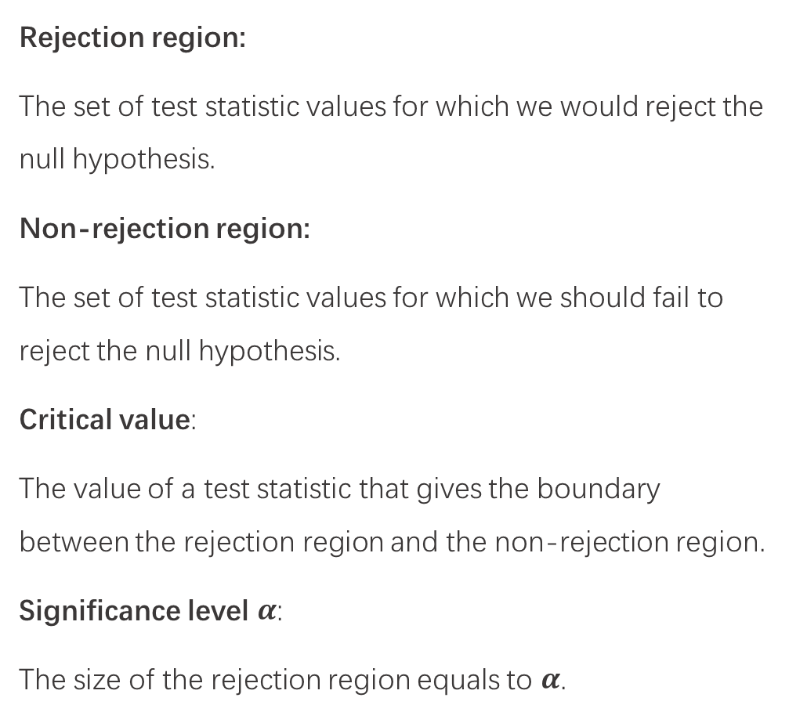
Rejection region & Non-rejection region:
Rejection region:
The set of test statistic values for which we would reject the null hypothesis.
Non-rejection region:
The set of test statistic values for which we should fail to reject the null hypothesis.
Critical value:
The value of a test statistic that gives the boundary between the rejection region and the non-rejection region.
Significance level $α$:
The size of the rejection region equals to $α$.

Slide 9
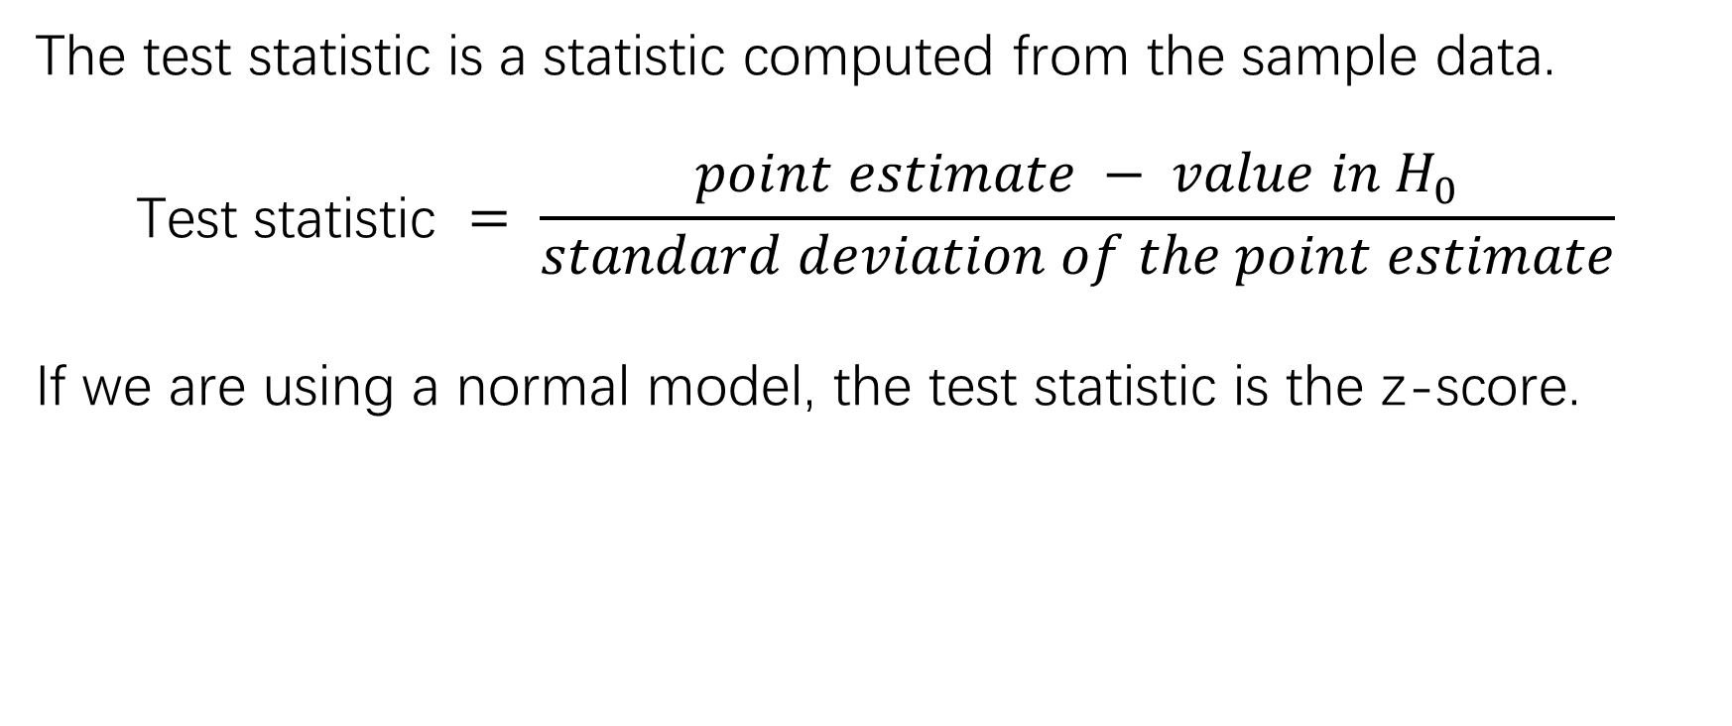
Test statistic
The test statistic is a statistic computed from the sample data.
$$\text{Test} \text{statistic} = \frac{point estimate − value in H_{0}}{standard deviation of the point estimate}$$
If we are using a normal model, the test statistic is the z-score.

Slide 10
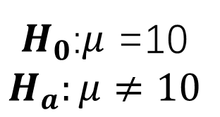
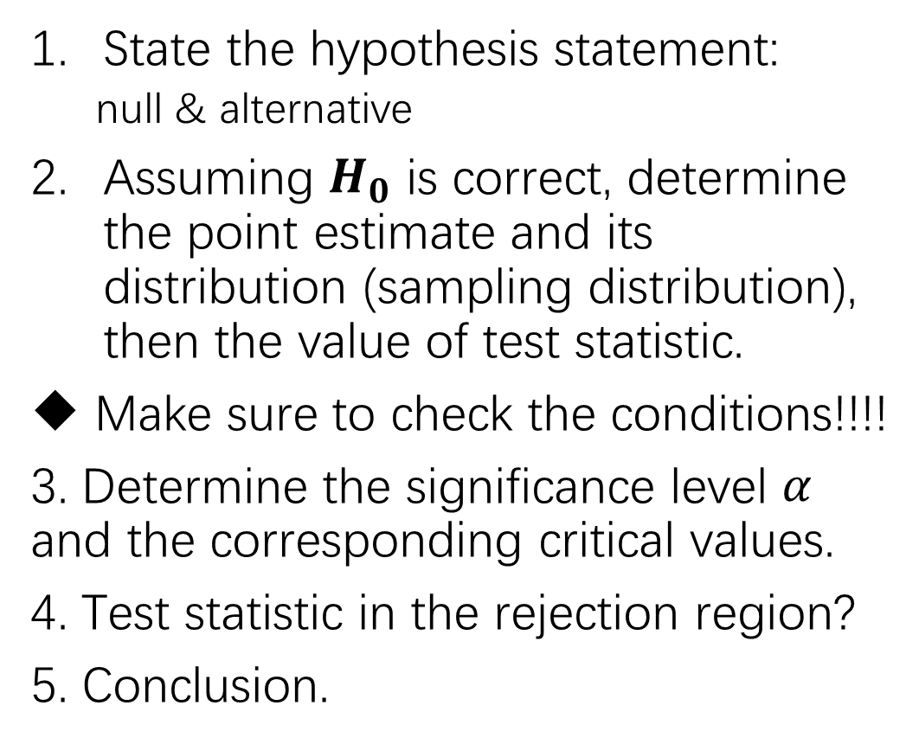


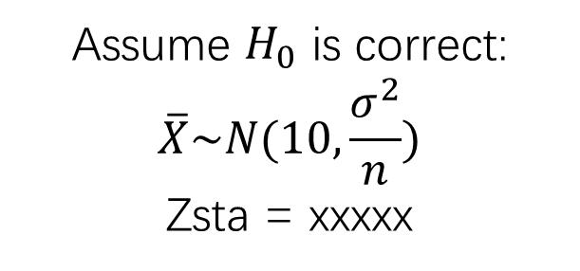
Steps for testing a hypothesis
$H_{0}$:$μ$ =10
$$H_{a}:μ≠10$$
State the hypothesis statement:
null & alternative
Assuming $H_{0}$ is correct, determine the point estimate and its distribution (sampling distribution), then the value of test statistic.
Make sure to check the conditions!!!!
3. Determine the significance level $α$ and the corresponding critical values.
4. Test statistic in the rejection region?
5. Conclusion.
Assume $H_{0}$ is correct:
$$\overline{X}\sim N(10,\frac{σ^{2}}{n})$$
Zsta = xxxxx
Critical value $Z_{\frac{α}{2}}$
Rejection region: |Zsta| > $Z_{\frac{α}{2}}$ ??
Conclusion

Slide 11
P-values
Definition:
Assuming H₀ is true, the probability that the statistic would take a value as extreme as or more extreme than the one actually observed is called the P-value of the test. The smaller the P-value, the stronger the evidence against H₀ provided by the data.
Small P-values are evidence against H₀ because they say that the observed result is unlikely to occur when H₀ is true.
Large P-values fail to give convincing evidence against H₀ because they say that the observed result is likely to occur by chance when H₀ is true.

Slide 12
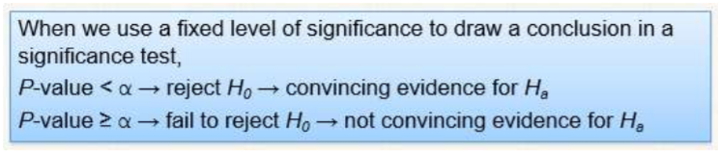
Significance level α
Definition:
If the P-value is smaller than alpha, we say that the data are statistically significant at level α. In that case, we reject the null hypothesis H₀ and conclude that there is convincing evidence in favor of the alternative hypothesis H_{a}.
When our P-value is less than the chosen α, we say that the result is statistically significant.

Slide 13

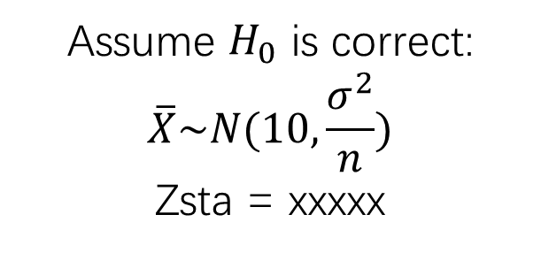
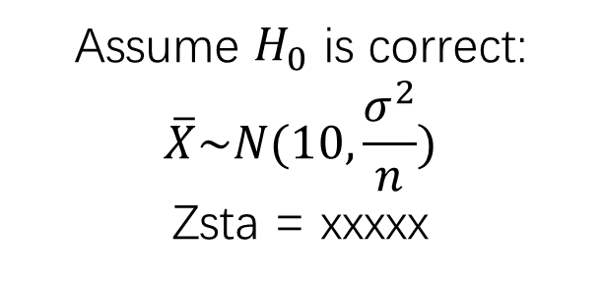
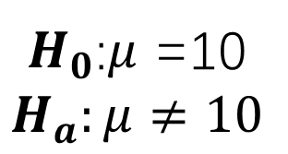
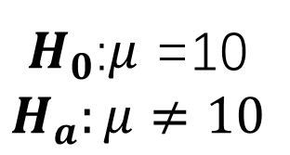


$H_{0}$:$μ$ =10
$$H_{a}:μ≠10$$
$H_{0}$:$μ$ =10
$$H_{a}:μ≠10$$
Assume $H_{0}$ is correct:
$$\overline{X}\sim N(10,\frac{σ^{2}}{n})$$
Zsta = xxxxx
Assume $H_{0}$ is correct:
$$\overline{X}\sim N(10,\frac{σ^{2}}{n})$$
Zsta = xxxxx
Critical value $Z_{\frac{α}{2}}$
p-value =P(|Z|>Zsta)
Rejection region: |Zsta| > $Z_{\frac{α}{2}}$ ??
P<$\frac{α}{2}$ ??
Conclusion
Conclusion

Slide 14

Large-Sample Hypothesis Test for a Population Proportion
H0: p=0.8
Ha: p<0.8
where p is the hit probability.
If H0 is correct, $\hat{p}\sim N\left(p,\frac{p(1−p)}{n}\right)$
Test statistic: $Z=\frac{\hat{p}−p}{\sqrt{\frac{p(1−p)}{n}}}\sim N\left(0,1\right)$

Slide 15
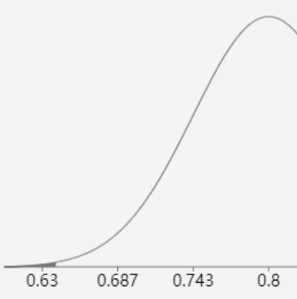

Large-Sample Hypothesis Test for a Population Proportion
How unlikely was the proportion we sampled?
$Z=\frac{\hat{p}−p}{\sqrt{\frac{p(1−p)}{n}}}= \frac{0.64−0.8}{\sqrt{\frac{0.8(1−0.8)}{50}}}$ = … (calculator)
Z
Under the assumption that the player is an 80% free-throw shooter, the actually observed data (64% of 50 free-throws) is highly unlikely (p-value = 0.002).
So, I reject the null hypothesis.
There’s convincing evidence that the player is not an 80% free-throw shooter.
VERY UNLIKELY!

Slide 16
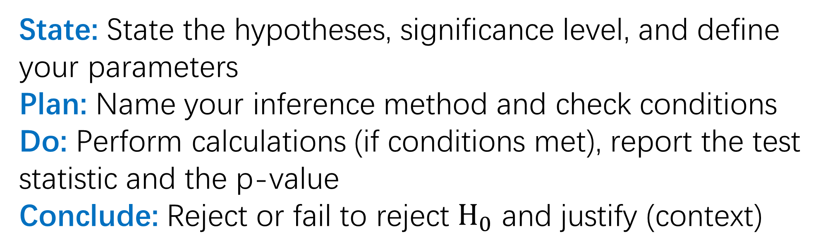
The Four Steps for Inference
A suggested way to organize your work so that you get full credit on FRQ’s!
State: State the hypotheses, significance level, and define your parameters
Plan: Name your inference method and check conditions
Do: Perform calculations (if conditions met), report the test statistic and the p-value
Conclude: Reject or fail to reject $H_{0}$ and justify (context)

Slide 17
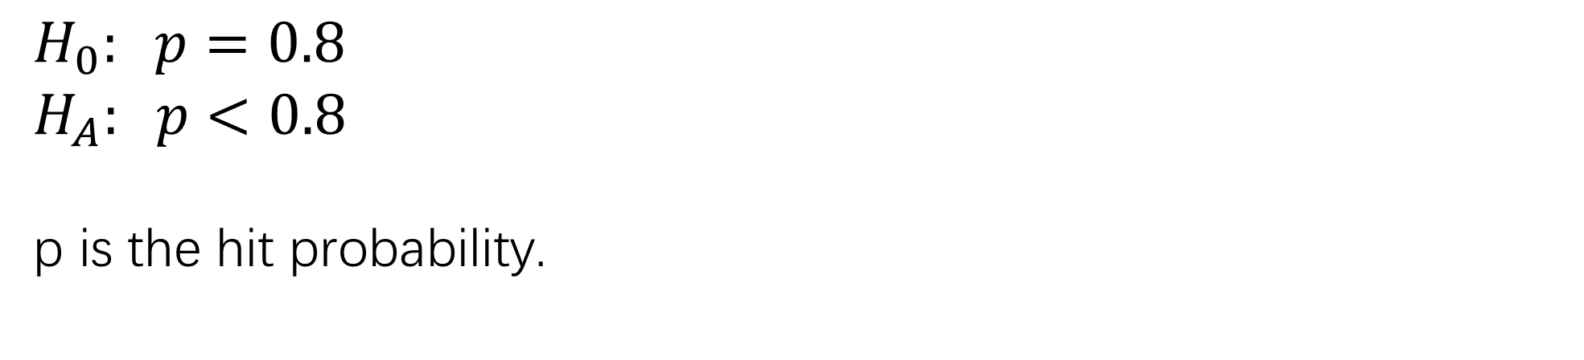
State-Plan-Do-Conclude
State: State the hypotheses, significance level, and define your parameters
$$H_{0}: p=0.8$$
$$H_{A}: p<0.8$$
p is the hit probability.
Significance Level: α = 0.05 (according to the question)

Slide 18
State-Plan-Do-Conclude
Plan: Name your inference method and check conditions
We will conduct an one-sample z-test for p, if all conditions are met.

Slide 19
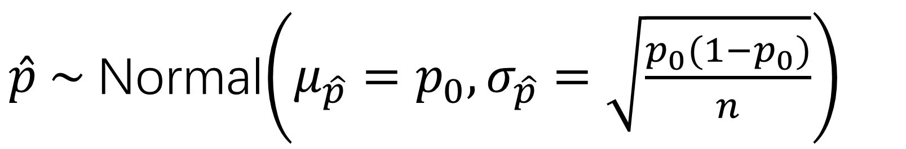
Recall: Why we check conditions
$\hat{p} \sim$Normal$\left(μ_{\hat{p}}=p_{0},σ_{\hat{p}}=\sqrt{\frac{p_{0}(1−p_{0})}{n}}\right)$
2) 10% condition
→ calculable spread
3) Large counts
→ approx. normal
shape
1) Random condition
→ unbiased center

Slide 20



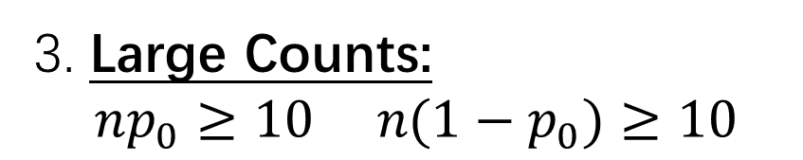
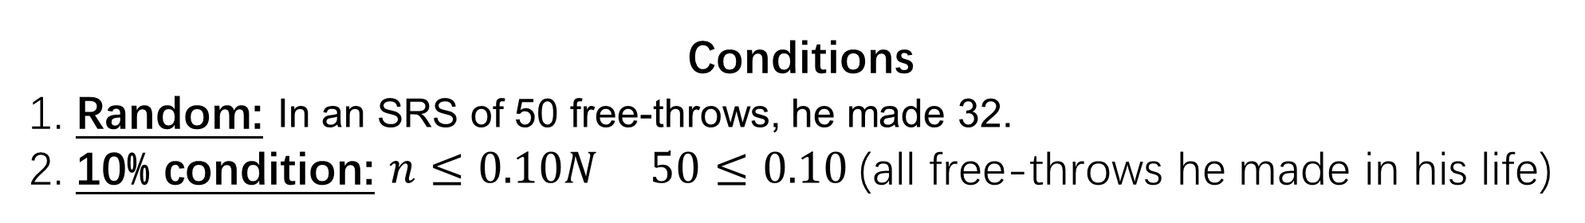
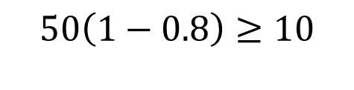

State-Plan-Do-Conclude
Plan: Name your inference method and check conditions
We will conduct an one-sample z-test for p, if all conditions are met.
Conditions
1. Random: In an SRS of 50 free-throws, he made 32.
2. 10% condition: $n≤0.10N$ $50≤0.10$(all free-throws he made in his life)
3. Large Counts:
$np_{0}≥10 n(1−p_{0})≥10$
$$50\left(0.8\right)≥10$$
$$50\left(1−0.8\right)≥10$$

Slide 21
State-Plan-Do-Conclude
Do: Perform calculations (if conditions met), report the test statistic and the p-value
z = ？
p-value = ?

Slide 22
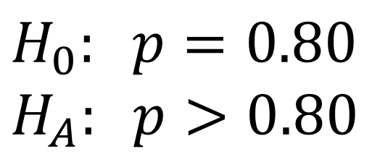
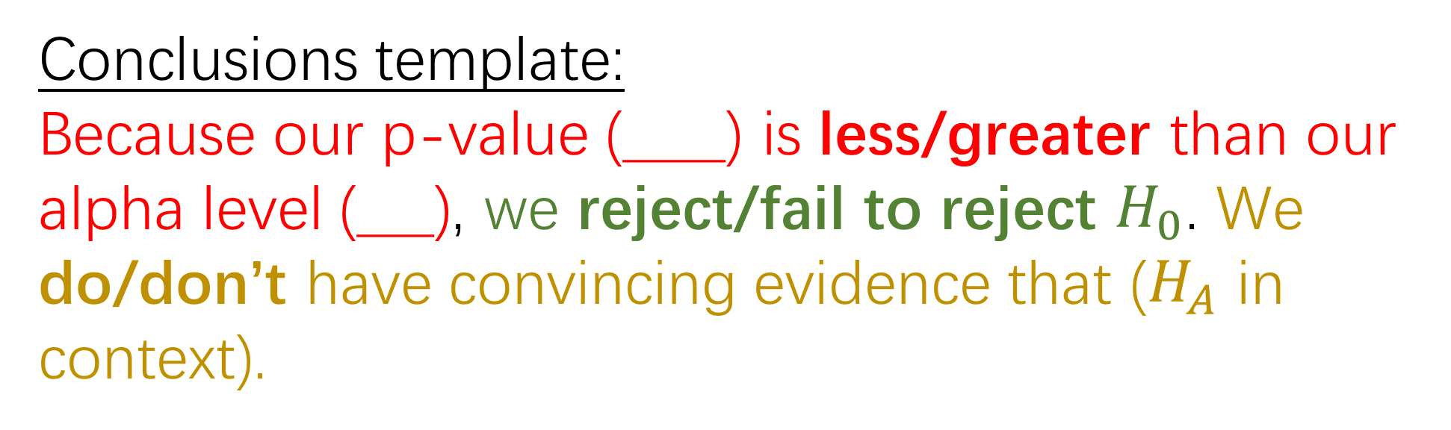
State-Plan-Do-Conclude
Conclude: Reject or fail to reject $H_{0}$ and justify
$$H_{0}: p=0.80$$
$$H_{A}: p>0.80$$
z = -2.86
p-value = 0.002
α = 0.05
Conclusions template:
Because our p-value (____) is less/greater than our alpha level (___), we reject/fail to reject $H_{0}$. We do/don’t have convincing evidence that ($H_{A}$ in context).

Slide 23
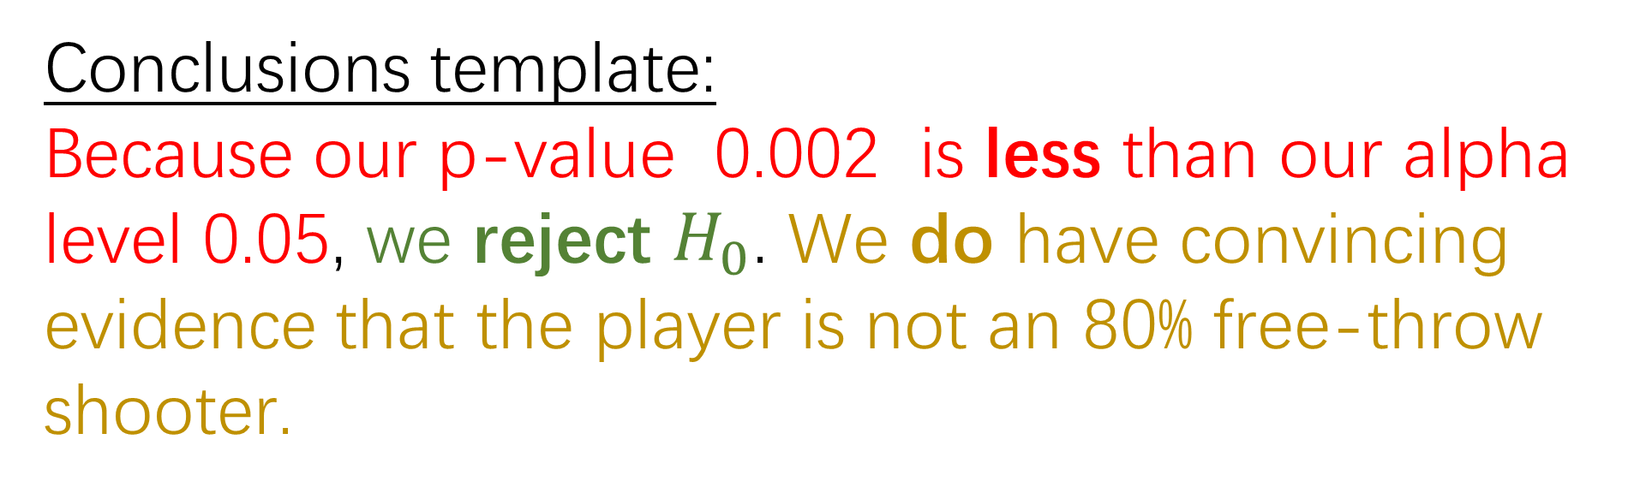
State-Plan-Do-Conclude
Conclude: Reject or fail to reject $H_{0}$ and justify
$$H_{0}: p=0.80$$
$$H_{A}: p>0.80$$
z = -2.86
p-value = 0.002
α = 0.05
Conclusions template:
Because our p-value 0.002 is less than our alpha level 0.05, we reject $H_{0}$. We do have convincing evidence that the player is not an 80% free-throw shooter.

Slide 24
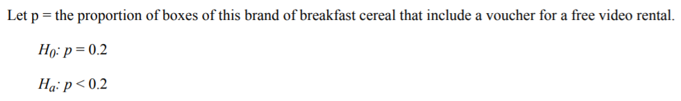

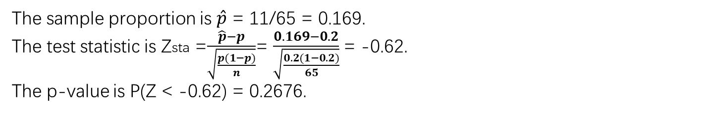
State a correct pair of hypotheses.
Identify a correct test (by name or by formula) and check appropriate conditions.
We will set an one-sample z-test for a proportion
Conditions:
The 65 boxes are a random sample.
n=65 < 10% * all boxes of this cereal.
np=65*0.2>10 n(1-p) = 65*0.8>10
Use correct mechanics and calculations, and provide the p-value (or rejection region).
The sample proportion is $\hat{p}$ = 11/65 = 0.169.
The test statistic is Zsta =$\frac{\hat{p}−p}{\sqrt{\frac{p(1−p)}{n}}}$= $\frac{0.169−0.2}{\sqrt{\frac{0.2(1−0.2)}{65}}}$= -0.62.
The p-value is P(Z < -0.62) = 0.2676.
State a correct conclusion in the context of the problem, using the result of the statistical test.
Since the p-value = 0.2676 is larger than any reasonable significance level (e.g.,α = 0.05 ), we cannot reject the company’s claim. That is, we do not have statistically significant evidence to support the student’s belief that the proportion of cereal boxes with vouchers is less than 20 percent

Slide 25
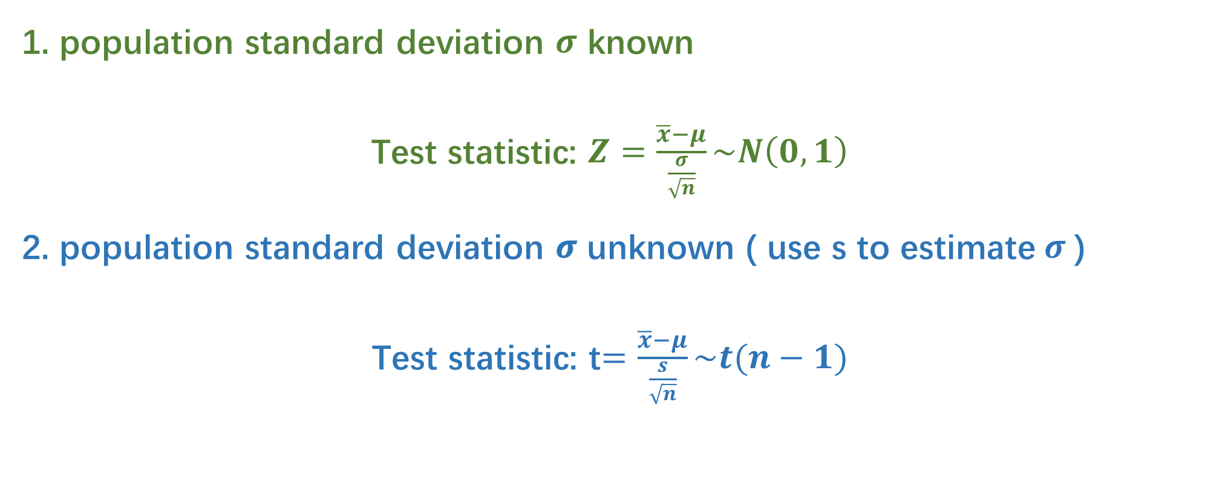
Large-Sample Hypothesis Test for a Population Mean
1. population standard deviation $σ$ known
Test statistic: $Z=\frac{\overline{x}−μ}{\frac{σ}{\sqrt{n}}}\sim N\left(0,1\right)$
2. population standard deviation 𝝈 unknown ( use s to estimate$σ$)
Test statistic: t$=\frac{\overline{x}−μ}{\frac{s}{\sqrt{n}}}\sim t(n−1)$

Slide 26
If the standard deviation is unknown…
We need to estimate the value of the standard deviation using the sample data ! !
The probability that our statistic is reasonable is higher ? or lower ?

Slide 27
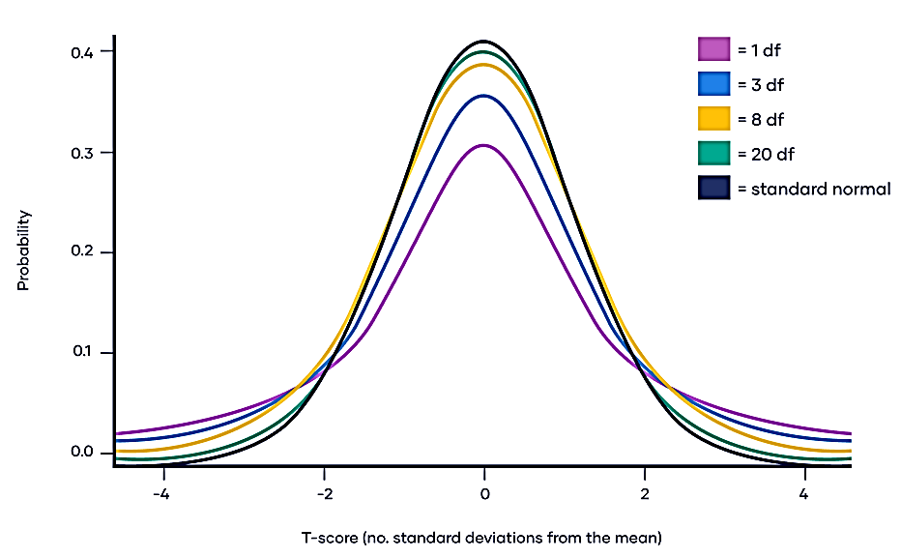

Slide 28
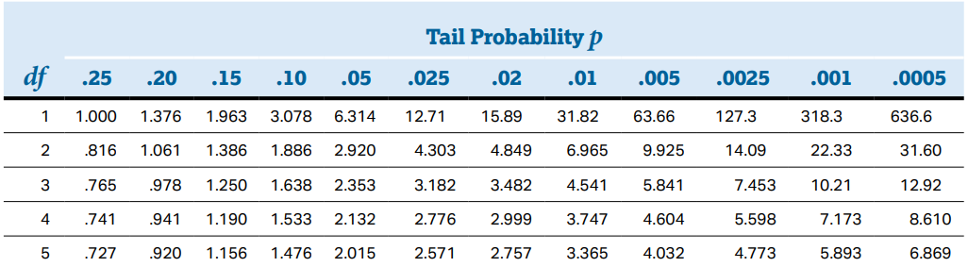
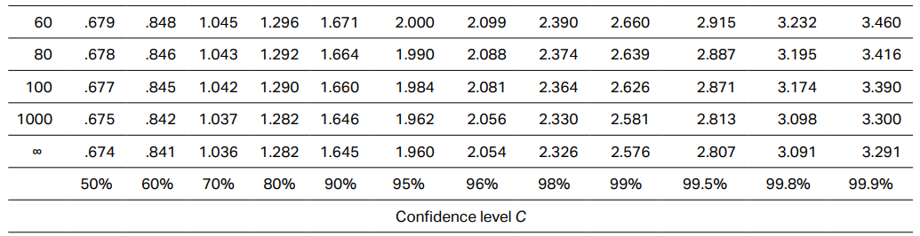
… …

Slide 29
https://www.youtube.com/watch?v=GFzCIA9kppM

Slide 30
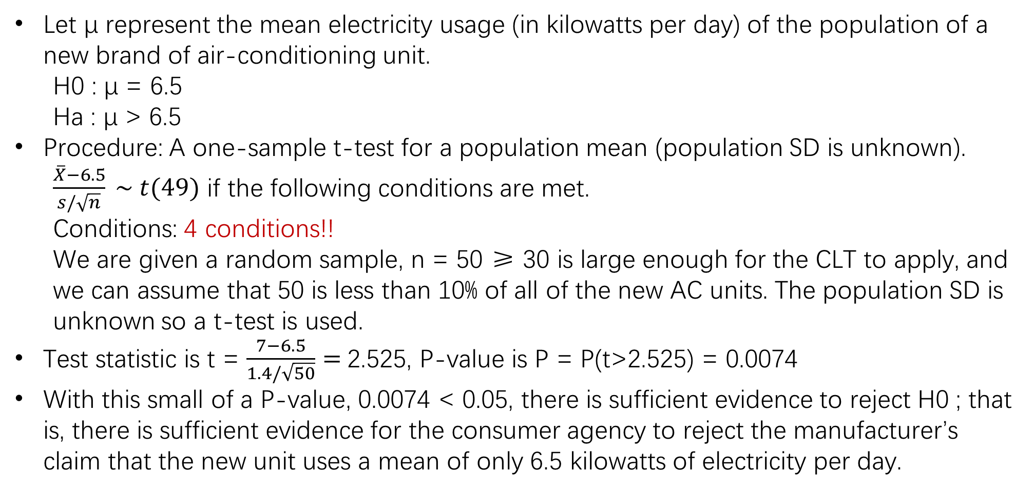
Let μ represent the mean electricity usage (in kilowatts per day) of the population of a new brand of air-conditioning unit.
H0 : μ = 6.5
Ha : μ > 6.5
Procedure: A one-sample t-test for a population mean (population SD is unknown).
$\frac{\overline{X}−6.5}{s/\sqrt{n}} \sim t(49)$ if the following conditions are met.
Conditions: 4 conditions!!
We are given a random sample, n = 50 ≥ 30 is large enough for the CLT to apply, and we can assume that 50 is less than 10% of all of the new AC units. The population SD is unknown so a t-test is used.
Test statistic is t = $\frac{7−6.5}{1.4/\sqrt{50}}=$2.525, P-value is P = P(t>2.525) = 0.0074
With this small of a P-value, 0.0074 < 0.05, there is sufficient evidence to reject H0 ; that is, there is sufficient evidence for the consumer agency to reject the manufacturer’s claim that the new unit uses a mean of only 6.5 kilowatts of electricity per day.

Slide 31
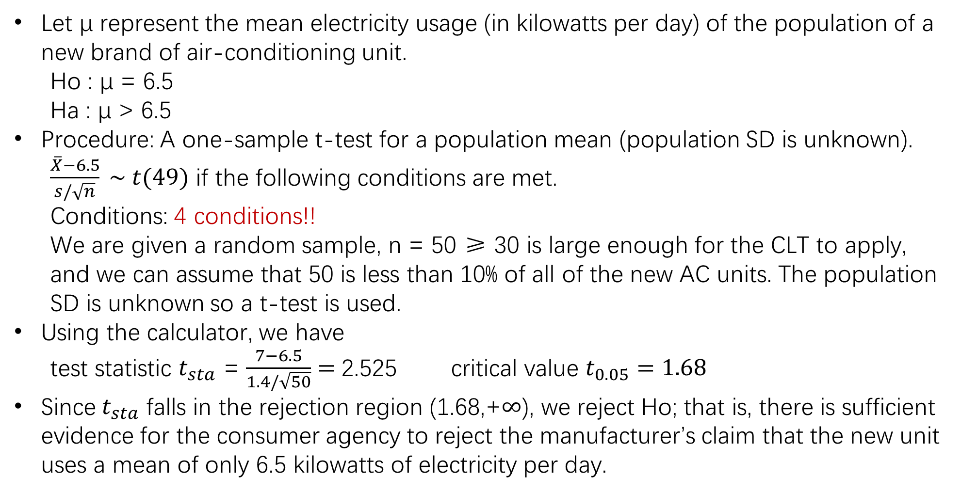
Let μ represent the mean electricity usage (in kilowatts per day) of the population of a new brand of air-conditioning unit.
Ho : μ = 6.5
Ha : μ > 6.5
Procedure: A one-sample t-test for a population mean (population SD is unknown).
$\frac{\overline{X}−6.5}{s/\sqrt{n}} \sim t(49)$ if the following conditions are met.
Conditions: 4 conditions!!
We are given a random sample, n = 50 ≥ 30 is large enough for the CLT to apply, and we can assume that 50 is less than 10% of all of the new AC units. The population SD is unknown so a t-test is used.
Using the calculator, we have
test statistic $t_{sta}$ = $\frac{7−6.5}{1.4/\sqrt{50}}=$2.525 critical value $t_{0.05}=1.68$
Since$t_{sta}$ falls in the rejection region (1.68,+$∞$), we reject Ho; that is, there is sufficient evidence for the consumer agency to reject the manufacturer’s claim that the new unit uses a mean of only 6.5 kilowatts of electricity per day.

Slide 32

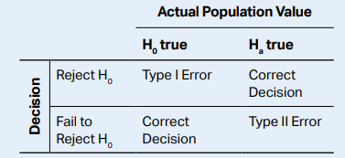
Type 1 error & Type 2 error
Performing a test
Reject the null hypothesis
OR
Fail to reject the null hypothesis
Wrong Decision | Correct Decision
Correct Decision | Wrong Decision

Slide 33
Type 1 error & Type 2 error
Type 1 error ( false positive ):
A type 1 error occurs when the null hypothesis is rejected although it is true.
Type 2 error ( false negative ):
A type 2 error occurs when the null hypothesis is false but we fail to reject it.

Slide 34
What is the value of P(type 1 error occurs)?

Slide 35
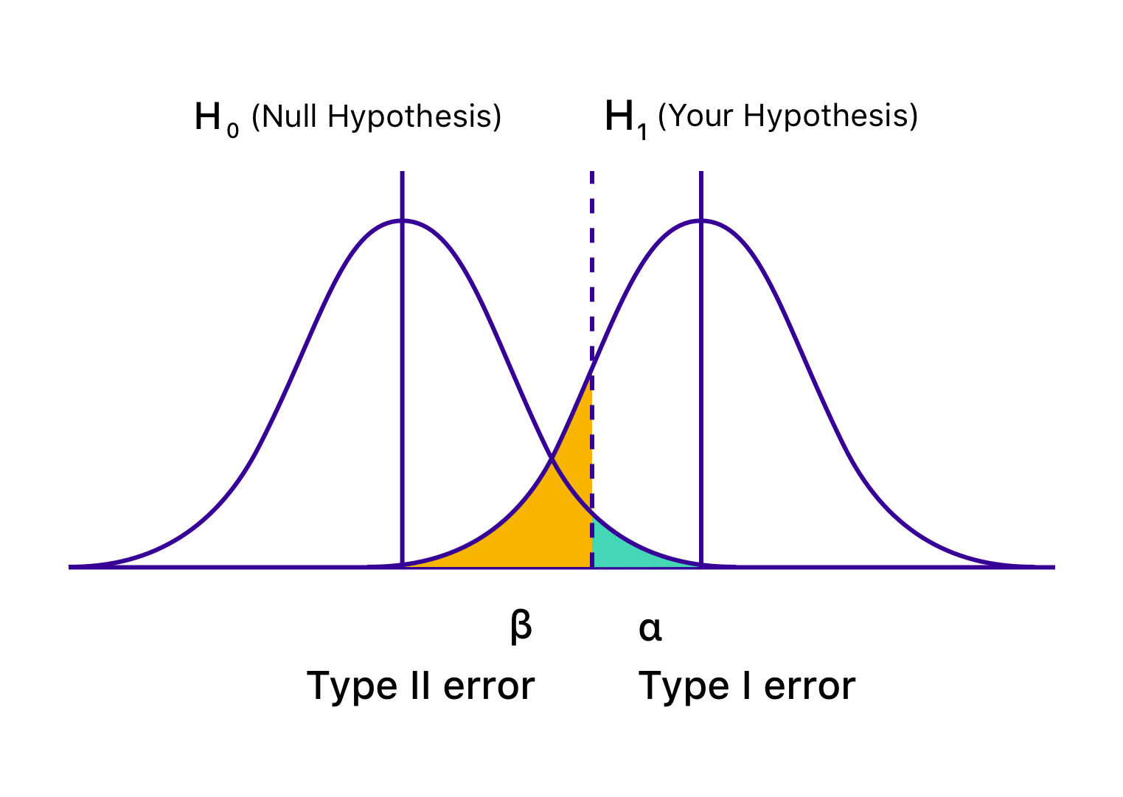

Def. Power
Power = 1-$β$
= 1-P(type II error occurs)

Slide 36
Practice!
http://www.ltcconline.net/greenL/java/statistics/catstatprob/categorizingstatproblemsjavascript.html

Slide 37
Given the above conclusion, what type of error, Type-I or Type-II, might have been committed, and what would be a possible consequence?
Answer: There was sufficient evidence to reject the null hypothesis. If the null hypothesis were true, we would be committing a Type-I error, that is, mistakenly rejecting a true null hypothesis. A possible consequence here is that the consumer agency would discourage customers from purchasing a new brand of air-conditioning unit that really was saving on electricity consumption as advertised.

Slide 38
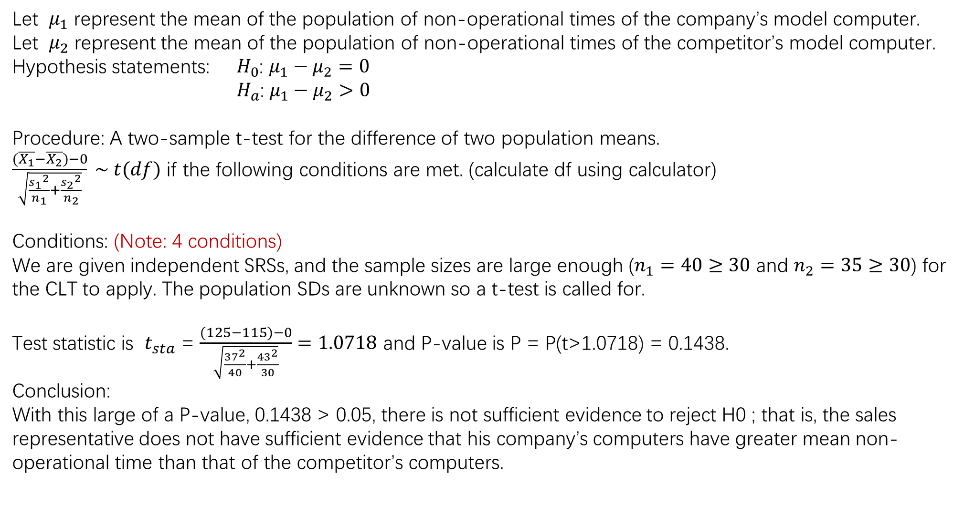
Let $μ_{1}$ represent the mean of the population of non-operational times of the company’s model computer.
Let $μ_{2}$ represent the mean of the population of non-operational times of the competitor’s model computer.
Hypothesis statements: $H_{0}$: ${μ_{1}−μ}_{2}=0$
$H_{a}$: ${μ_{1}−μ}_{2}>0$
Procedure: A two-sample t-test for the difference of two population means.
$\frac{(\overline{X_{1}}−\overline{X_{2}})−0}{\sqrt{\frac{{s_{1}}^{2}}{n_{1}}+\frac{{s_{2}}^{2}}{n_{2}}}} \sim t(df)$ if the following conditions are met. (calculate df using calculator)
Conditions: (Note: 4 conditions)
We are given independent SRSs, and the sample sizes are large enough ($n_{1}=40≥30$ and $n_{2}=35≥30$) for the CLT to apply. The population SDs are unknown so a t-test is called for.
Test statistic is $t_{sta}$ = $\frac{(125−115)−0}{\sqrt{\frac{{37}^{2}}{40}+\frac{{43}^{2}}{30}}}=1.0718$ and P-value is P = P(t>1.0718) = 0.1438.
Conclusion:
With this large of a P-value, 0.1438 > 0.05, there is not sufficient evidence to reject H0 ; that is, the sales representative does not have sufficient evidence that his company’s computers have greater mean non-operational time than that of the competitor’s computers.

